Slide 1

GENERATIVE MODELS
Introduction to the article
"An Uncertain Future:
Forecasting from Static Images Using Variational Autoencoders"

Slide 2


ABOUT GENERATIVE MODELS
Models in machine learning that learn the underlying structure and patterns of a given dataset to generate new data samples that resemble the original training data.

Slide 3
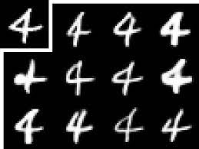

ABILITIES
Data Generation and Augmentation

Slide 4
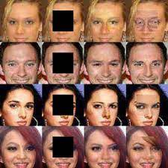
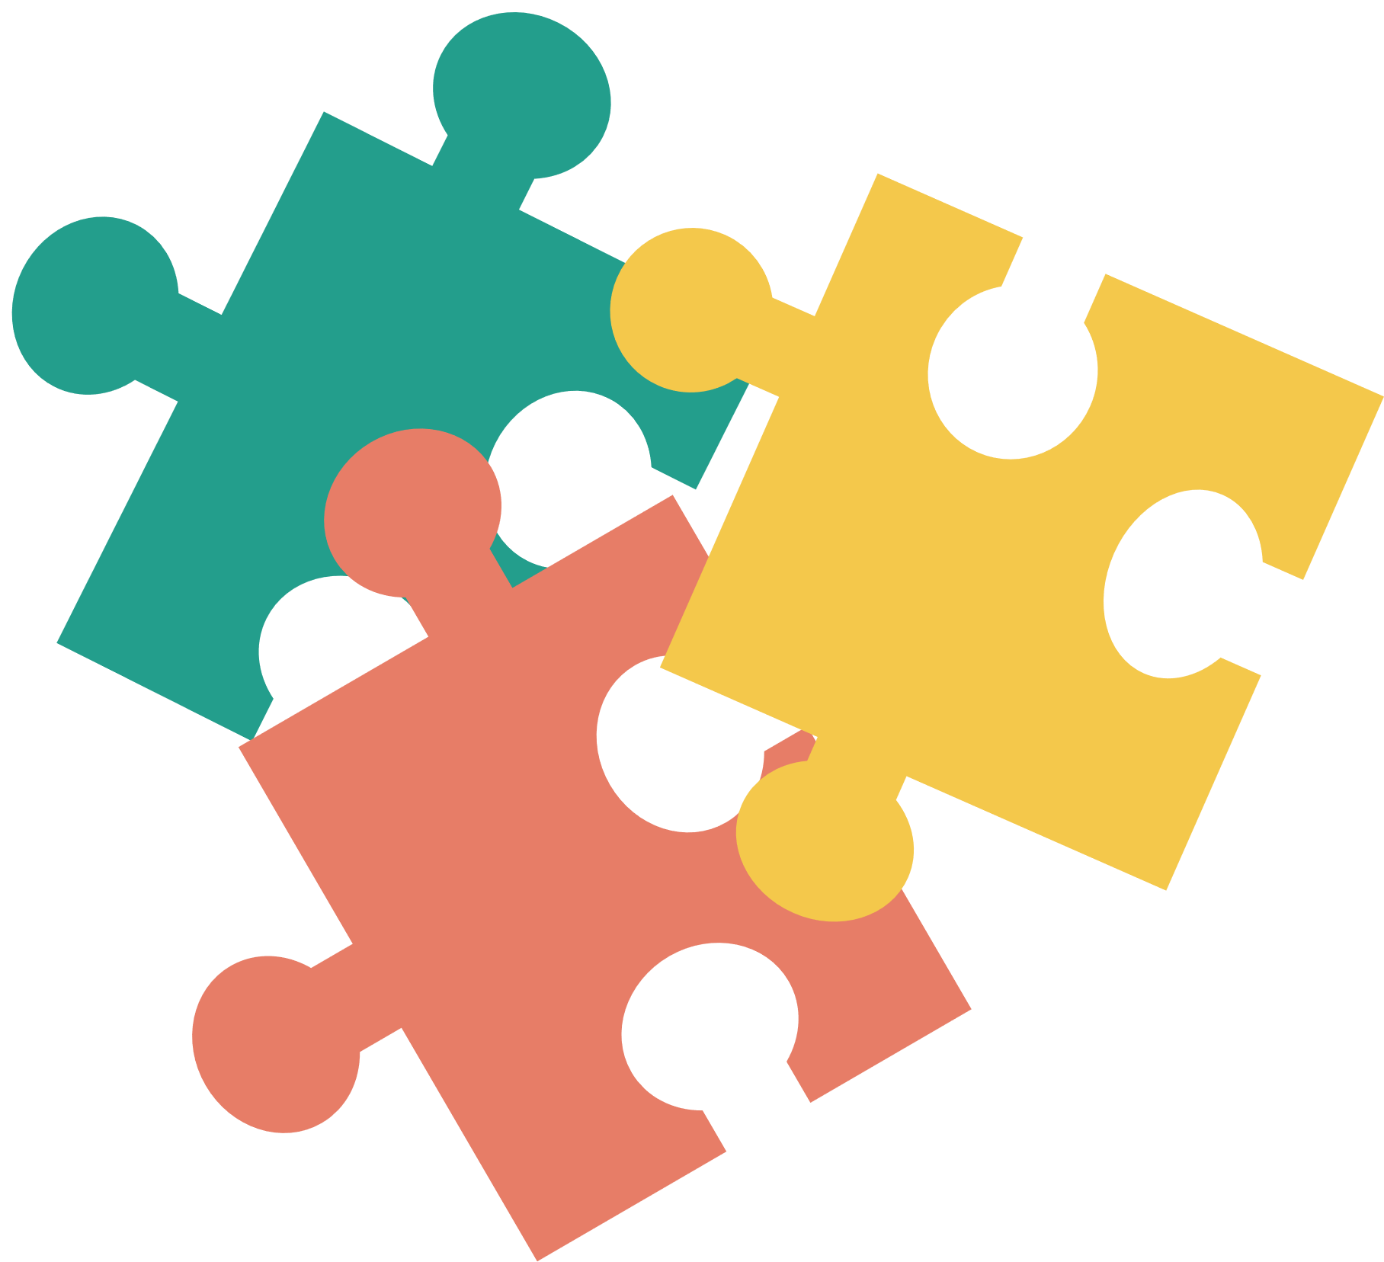
ABILITIES
Data Completion and Inpainting

Slide 5
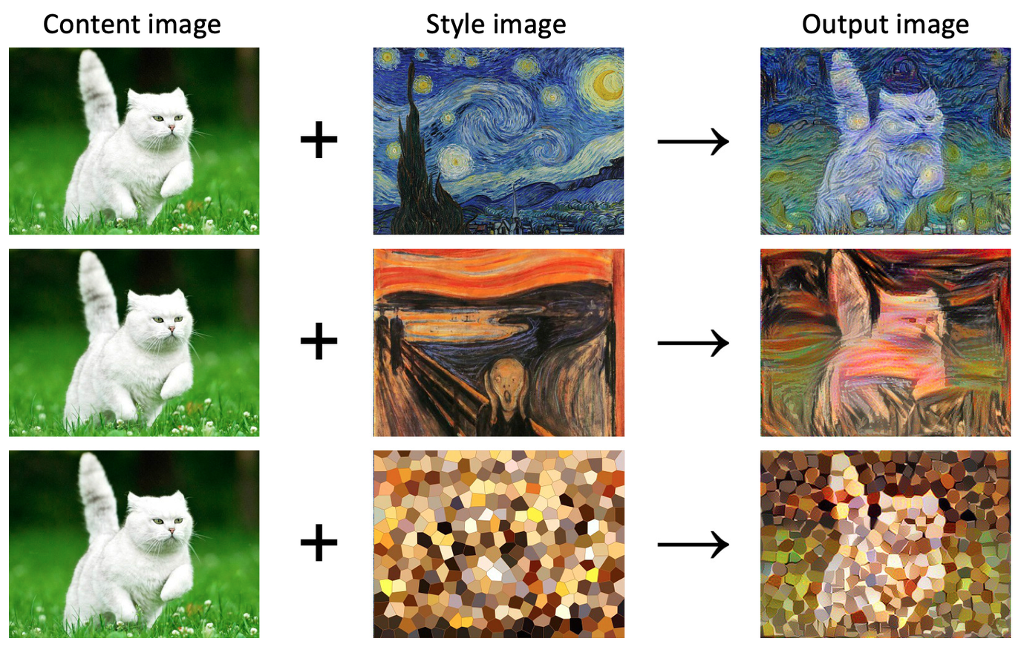

ABILITIES
Style Transfer and Manipulation

Slide 6

ABILITIES
Data Generation and Augmentation
Data Completion and Inpainting
Anomaly Detection
Style Transfer and Manipulation

Slide 7
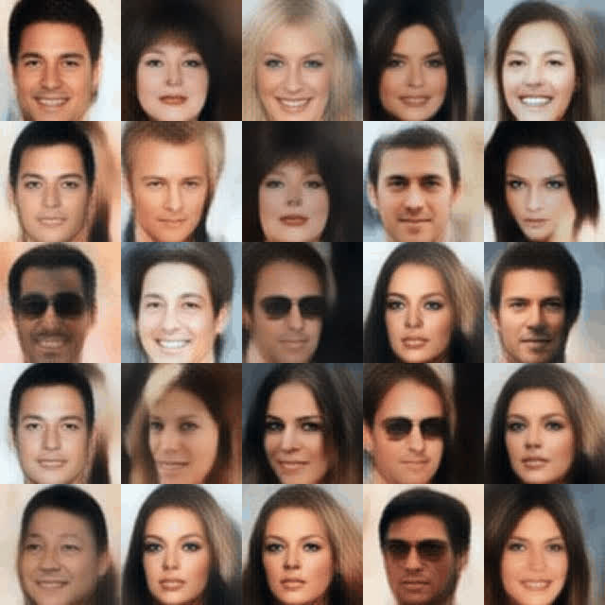
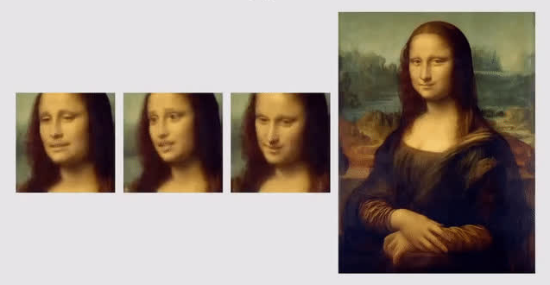
ABILITIES

Slide 8


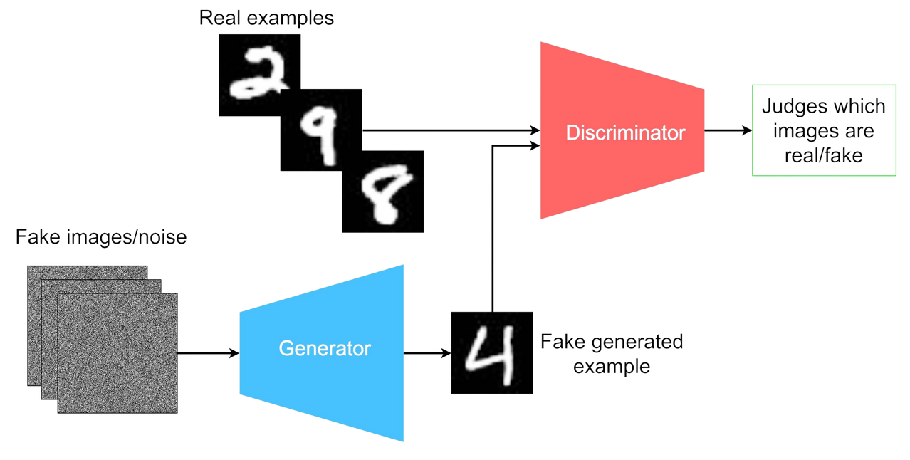
GAN
In a GAN, two neural networks contest with each other in the form of a zero-sum game, where one agent's gain is another agent's loss.
The generator is not trained to minimize the distance to a specific image, but rather to fool the discriminator. This enables the model to learn in an unsupervised manner.

Slide 9
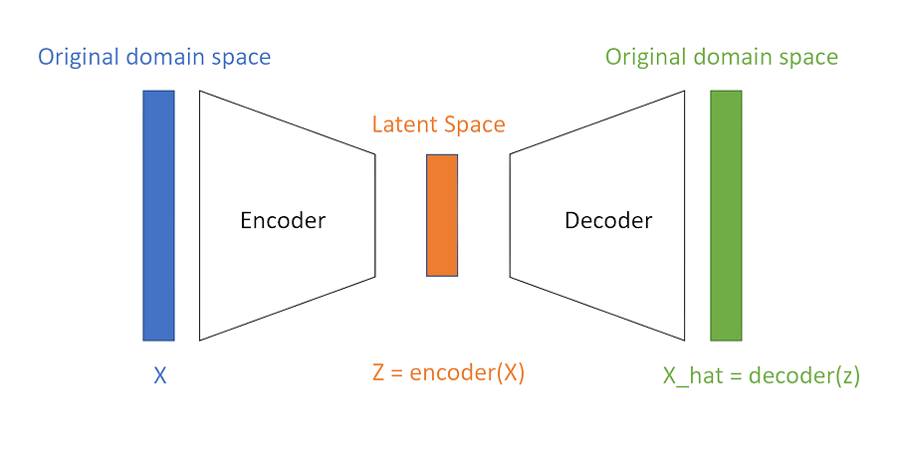
AUTOENCODER
An autoencoder aims to learn an efficient representation of the input data by encoding it into a lower-dimensional latent space and then decoding it back to reconstruct the original input.

Slide 10
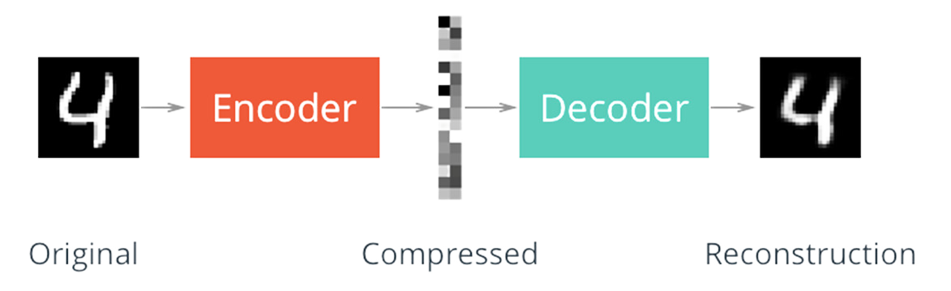
STRUCTURE
1.
ENCODER
The encoder takes the input data and maps it to a lower-dimensional representation.
2.
LATENT SPACE
The latent space is a compressed representation of the input data, capturing its essential characteristics.
3.
DECODER
The decoder takes the encoded representation and reconstructs the original input data from it, aiming to produce a reconstruction that is close as to the original input.

Slide 11

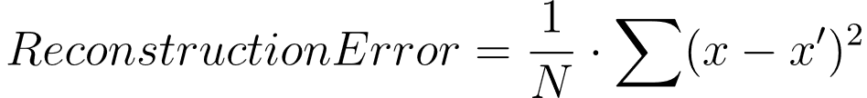
LOSS FUNCTION
RECONSTRUCTION LOSS
For continuous data, such as images, the reconstruction error is often calculated as the mean squared error (MSE) between the reconstructed output and the original input.
N is the number of dimensions or pixels in the input data
x is the original input data
x' is the reconstructed output

Slide 12



PROBLEM
We would like to allow a larger data creation space

Slide 13
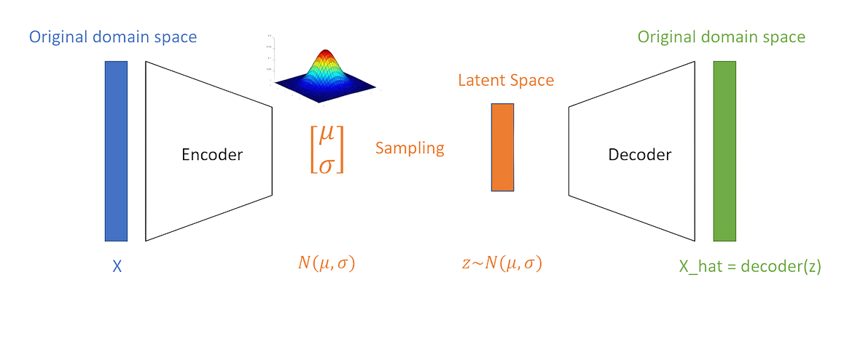
A Variational Autoencoder (VAE) combines elements of both autoencoders and variational inference to learn an efficient representation of input data and generate new samples from that learned representation.
VARIATIONAL AUTOENCODER

Slide 14
STRUCTURE
1.
ENCODER
The encoder network takes the input data and maps it to a lower-dimensional representation which is the parameters of a probability distribution.
2.
LATENT SPACE
Mean and standard deviation of the distribution.

Slide 15
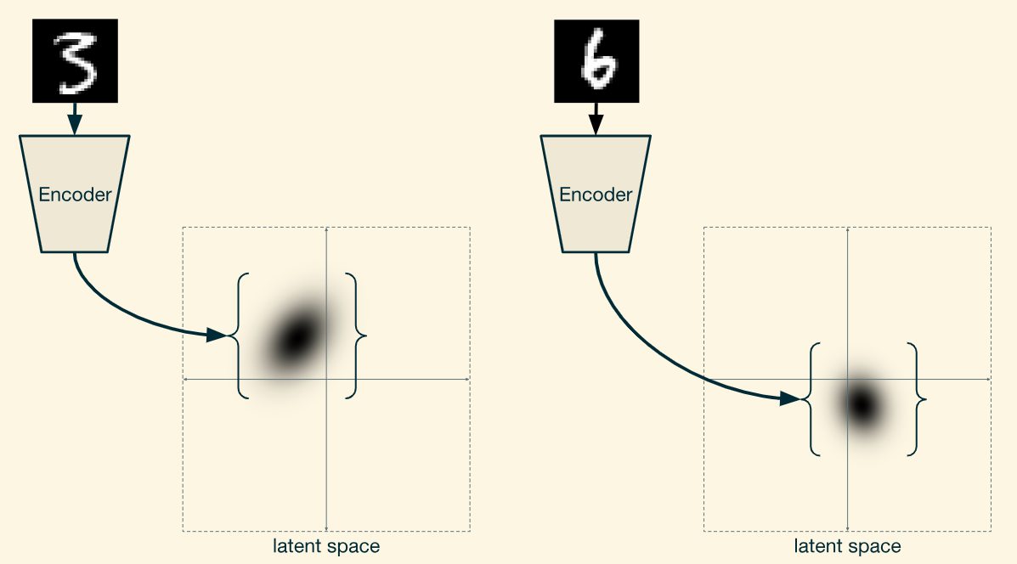

Slide 16
STRUCTURE
1.
ENCODER
The encoder network takes the input data and maps it to a lower-dimensional representation which is the parameters of a probability distribution.
2.
LATENT SPACE
Mean and standard deviation of the distribution.
3.
DECODER
The decoder takes the latent space sample and generate an output from it, aiming to produce a reasonable one.

Slide 17
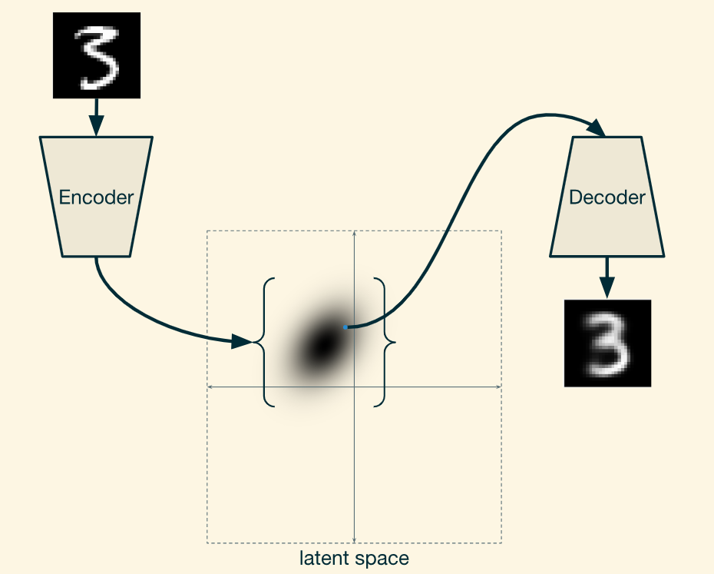

Slide 18
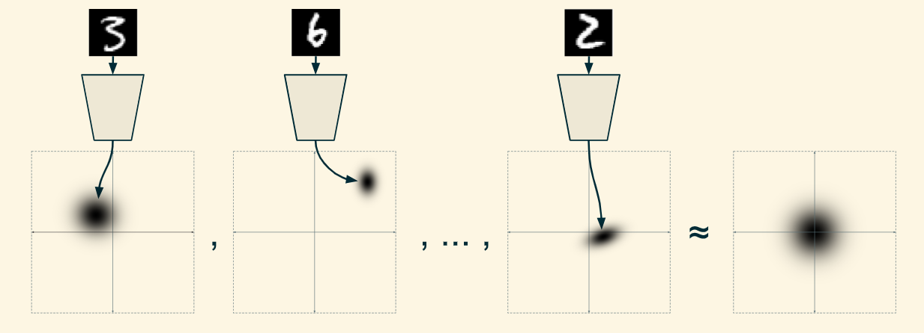
How do we ensure that the whole distribution approximates the standard normal distribution?

Slide 19
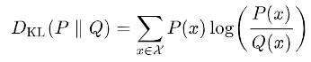
LOSS FUNCTION
VAE LOSS = RECONSTRUCTION LOSS + KL DIVERGENCE LOSS
RECONSTRUCTION LOSS
KL DIVERGENCE LOSS
KL divergence is a measure of dissimilarity between two probability distributions.
The KL divergence loss regularizes the latent space by ensuring that the approximate posterior distribution aligns with a normal distribution.

Slide 20
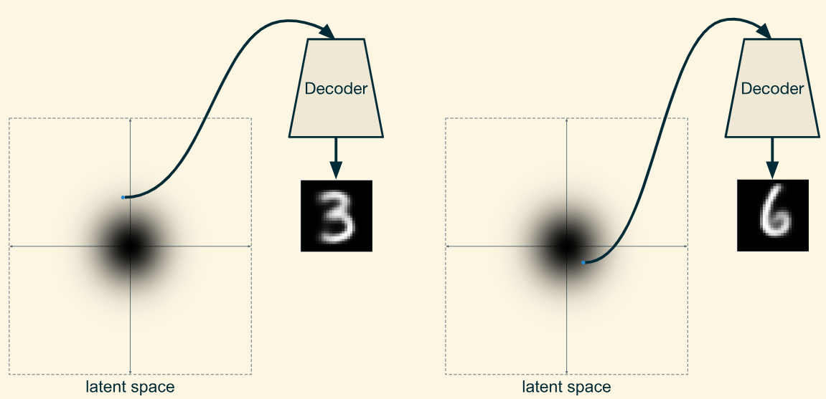

Slide 21
PROBLEM
Images of the same category cannot be created using VAE

Slide 22
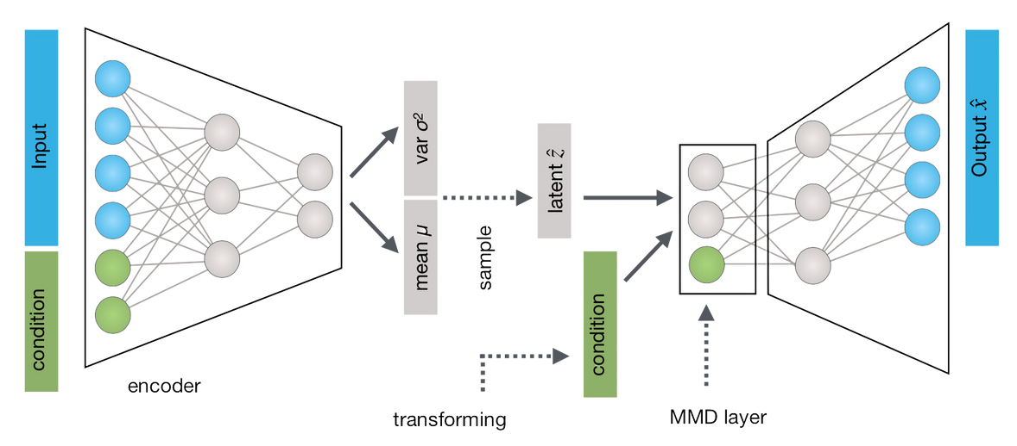
CONDITIONAL VARIATIONAL AUTOENCODER
A CVAE incorporates additional conditional information during the learning and generation process that allows for the generation of samples conditioned on specific information or attributes.

Slide 23
ABILITIES
Image generation conditioned on specific attributes
(e.g., generating images of specific classes).
Text generation with controlled attributes
(e.g., generating sentences with desired topics).

Slide 24
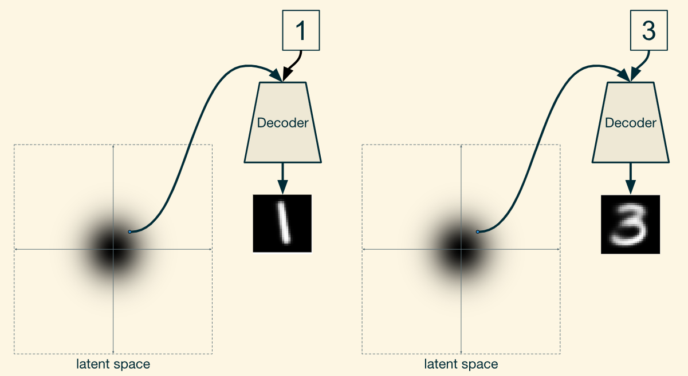
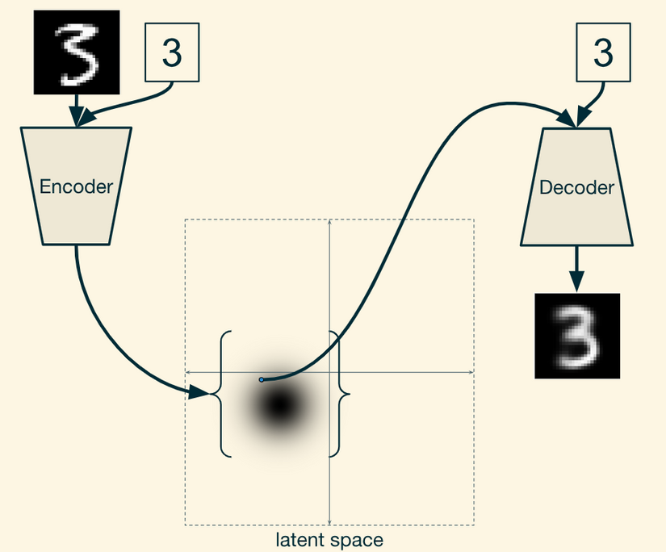
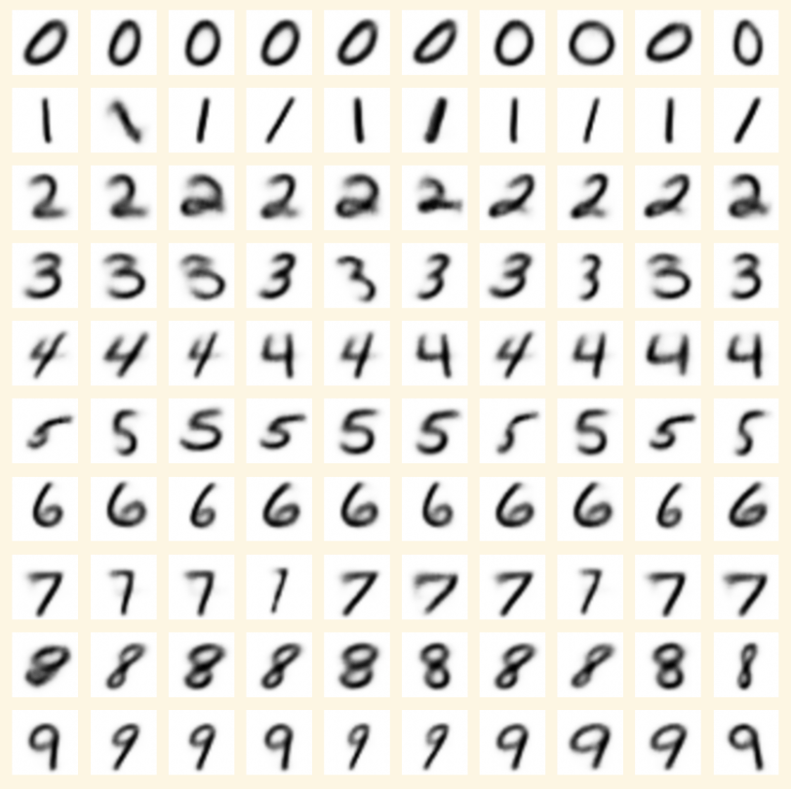

Slide 25
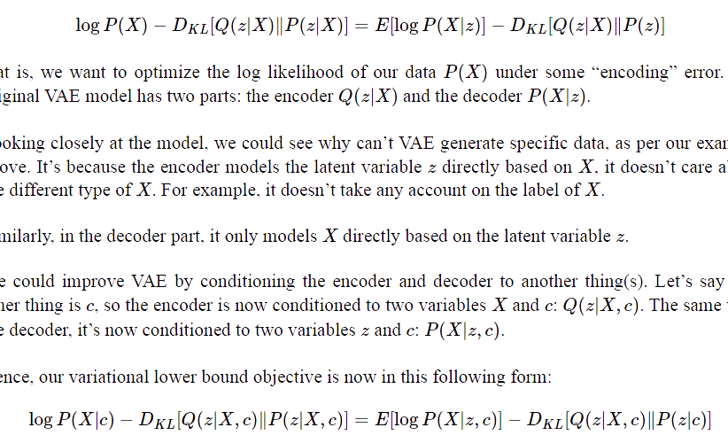
LOSS FUNCTION
VAE
CVAE

Slide 26

AUTOENCODERS EXAMPLES
Denoising Autoencoder
Stacked Autoencoder

Slide 27
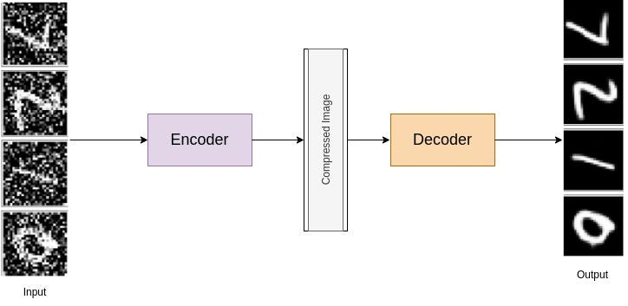
DENOISING
AUTOENCODER
A denoising autoencoder is specifically designed to handle noisy input data.
It is trained to learn a representation that captures the underlying structure of the data while being less sensitive to the noise.

Slide 28
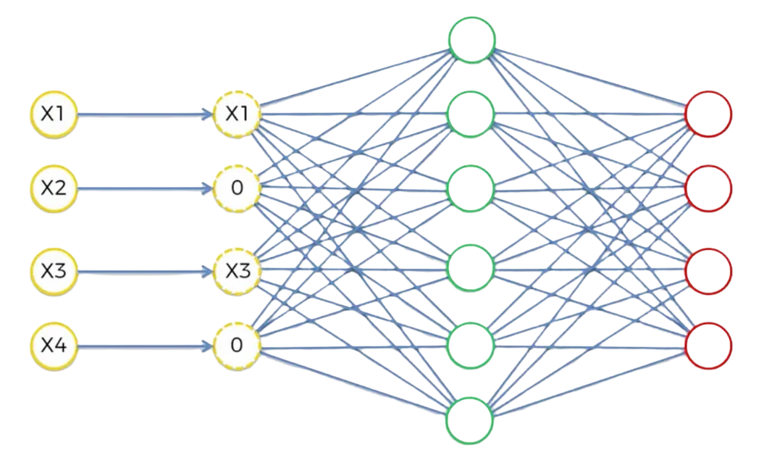
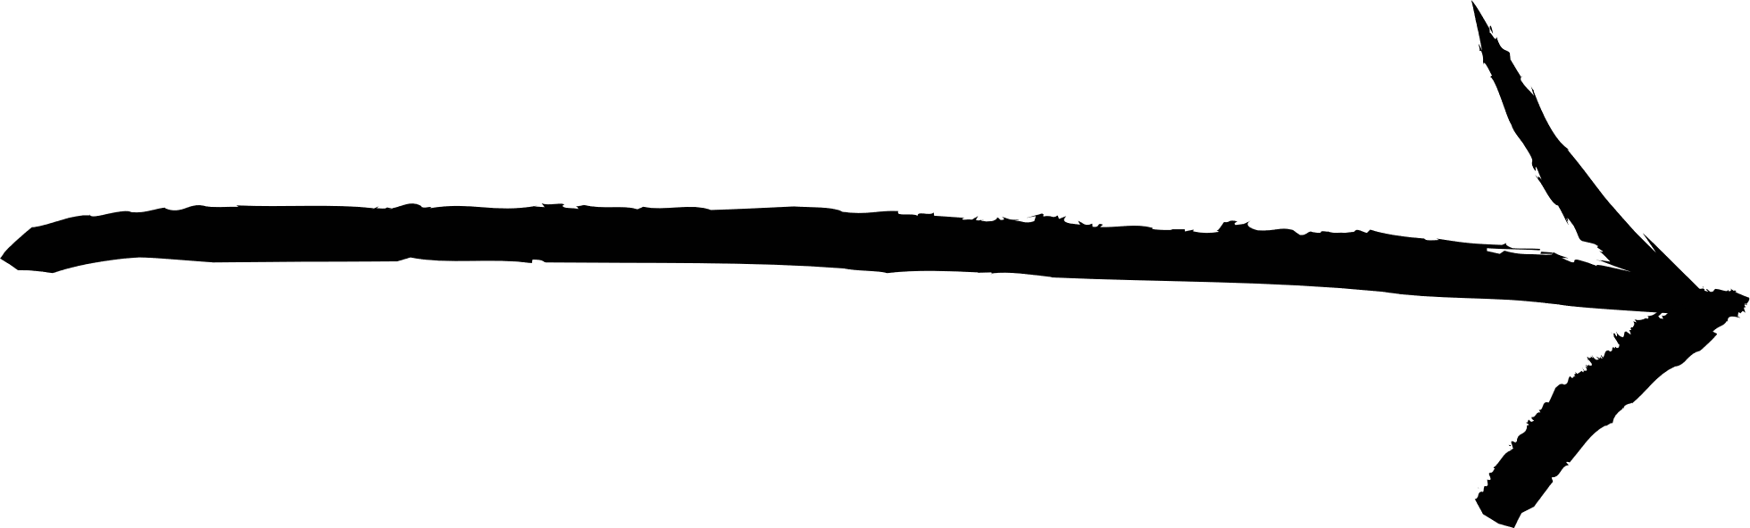
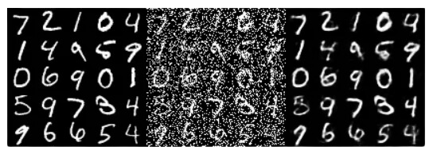
Comparing the
output values with the original input
Randomly turning some of the input values to zero

Slide 29
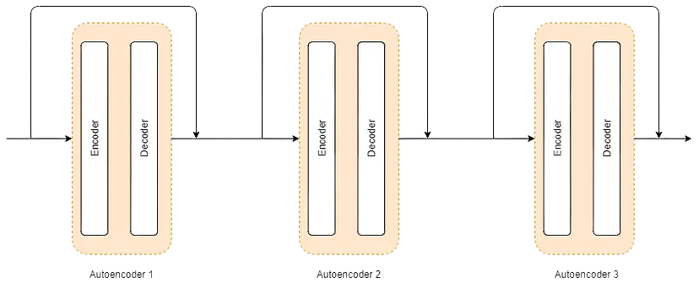
STACKED AUTOENCODER
A stacked autoencoder consists of multiple layers of encoders and decoders that are stacked on top of each other, forming a deep neural network.
Stacked autoencoders can learn more complex and hierarchical representations of the input data.
By adding more layers, the model can learn more complex data and capture higher-level features and abstract representations.

Slide 30


